Slide 1
CSE 207: Algorithms
Dr. Tanzima Hashem
Assistant Professor
CSE, BUET

Slide 2
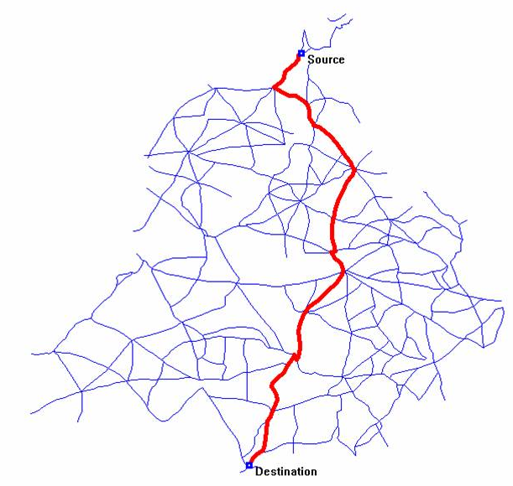
Variations:
Single source, single destination
Single source, all destinations
Single destination, all sources
All pairs
Solving 1 is asymptotically the same as solving 2
2 and 3 are equivalent
4 is different

Slide 3
Shortest Path Problems
How can we find the shortest route between two points on a map?
Model the problem as a graph problem:
  Road map is a weighted graph:
  vertices = cities
  edges = road segments between cities
  edge weights = road distances
  Goal: find a shortest path between two vertices (cities)

Slide 4
Many applications
Shortest paths model many useful real-world problems.
  Minimization of latency in the Internet.
  Minimization of cost in power delivery.
  Job and resource scheduling.
  Route planning.

Slide 5
Paths in graphs
Consider a directed graph G = (V, E) with edge-weight function w : E → R. The weight of path p = v₁ →
v₂ → ... → v_{k} is defined to be
.
Example:
v₁
v₃
v₅
4
–2
–5
1
v₂
v₄
w(p) = –2
Sometimes we use distance instead of weight when all edge weights are non-negative.

Slide 6
Shortest paths
A shortest path from u to v is a path of minimum weight from u to v. The shortest-path weight from u to v is defined as
δ(u, v) = min{w(p) : p is a path from u to v}.
Note: δ(u, v) = ∞ if no path from u to v exists.

Slide 7
Optimal substructure
Theorem. A subpath of a shortest path is a shortest path.
Proof. If the subpath between u and v is not the shortest, we can replace it with a shorter one and get a shorter path from s to t than the shortest path
s
u
v
t

Slide 8
Triangle inequality
Theorem. For all u, v, x ∈ V, we have
δ(u, v) ≤ δ(u, x) + δ(x, v).
Proof.
δ(u,v) minimizes over all paths from u to v
Concatenating two shortest paths from u to x and from x to v yields one specific path from u to v
u
δ(u, v)
v
δ(u, x)
δ(x, v)
x

Slide 9
Well-definedness of shortest paths
If a graph G contains a negative-weight cycle, then some shortest paths may not exist.
Example:
…
< 0
u
v

Slide 10
Cycles
Can shortest paths contain cycles?
Negative-weight cycles:
Positive-weight cycles:
  By removing the cycle we can get a shorter path
We will assume that when we are finding shortest paths, the paths will have no cycles
No!
No!

Slide 11
Shortest-Path Representation
For each vertex v ∈ V:
d[v] = δ(s, v): a shortest-path estimate
  Initially, d[v]=∞
  Reduces as algorithms progress
π[v] = predecessor of v on a shortest path from s
  If no predecessor, π[v] = NIL
  π induces a tree—shortest-path tree
Shortest paths & shortest path trees are not unique
t
x
3
6
9
3
4
s
0
2
1
2
7
5
3
5
11
6
y
z

Slide 12
Initialization
Alg.: INITIALIZE-SINGLE-SOURCE(V, s)
for each v ∈ V
do d[v] ← ∞
π[v] ← NIL
d[s] ← 0
All the shortest-paths algorithms start with INITIALIZE-SINGLE-SOURCE

Slide 13
Relaxation
Relaxing an edge (u, v) = testing whether we can improve the shortest path to v found so far by going through u
  If d[v] > d[u] + w(u, v)
  we can improve the shortest path to v
  ⇒ update d[v] and π[v]
s
s
u
v
u
v
After relaxation:
  d[v] ≤ d[u] + w(u, v)
5
2
9
5
2
6
RELAX(u, v, w)
RELAX(u, v, w)
u
v
u
v
5
2
7
5
2
6

Slide 14
RELAX(u, v, w)
if d[v] > d[u] + w(u, v)
then d[v] ← d[u] + w(u, v)
π[v] ← u
All the single-source shortest-paths algorithms
  start by calling INIT-SINGLE-SOURCE
  then relax edges
The algorithms differ in the order and how many times they relax each edge

Slide 15
Dijkstra’s Algorithm
Single-source shortest path problem:
  No negative-weight edges: w(u, v) > 0 ∀ (u, v) ∈ E
Maintains two sets of vertices:
  S = vertices whose final shortest-path weights have already been determined
  Q = vertices in V – S: min-priority queue
    Keys in Q are estimates of shortest-path weights (d[v])
Repeatedly select a vertex u ∈ V – S, with the minimum shortest-path estimate d[v]

Slide 16
Dijkstra (G, w, s)
INITIALIZE-SINGLE-SOURCE(V, s)
S ← ∅
Q ← V[G]
while Q ≠ ∅
do u ← EXTRACT-MIN(Q)
S ← S ∪ {u}
for each vertex v ∈ Adj[u]
do RELAX(u, v, w)

Slide 17
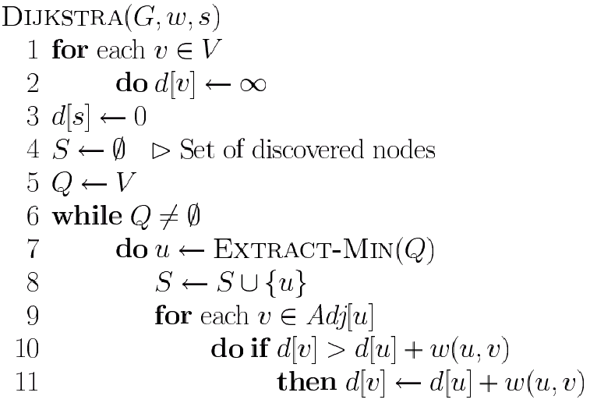
Dijkstra’s Pseudo Code
Graph G, weight function w, root s
relaxing edges

Slide 18
Example of Dijkstra’s algorithm
2
B
D
Graph with nonnegative edge weights:
10
A
8
1
4
7
9
3
C
E
2

Slide 19
Example of Dijkstra’s algorithm
∞
∞
2
Initialize:
B
D
10
S: {}
A
8
0
1
4
7
9
3
C
E
Q:
A
B
C
D
E
2
∞
∞
0
∞
∞
∞
∞

Slide 20
Example of Dijkstra’s algorithm
∞
∞
2
“A” ← EXTRACT-MIN(Q):
B
D
10
S: { A }
A
8
0
1
4
7
9
3
C
E
Q:
A
B
C
D
E
2
∞
∞
0
∞
∞
∞
∞

Slide 21
Example of Dijkstra’s algorithm
10
∞
2
Relax all edges
leaving A:
B
D
10
S: { A }
A
8
0
1
4
7
9
3
C
E
Q:
A
B
C
D
E
2
3
∞
0
∞
∞
∞
∞
10
3
−
−

Slide 22
Example of Dijkstra’s algorithm
10
∞
2
“C” ← EXTRACT-MIN(Q):
B
D
10
S: { A, C }
A
8
0
1
4
7
9
3
C
E
Q:
A
B
C
D
E
2
3
∞
0
∞
∞
∞
∞
10
3
−
−

Slide 23
Example of Dijkstra’s algorithm
7
11
2
Relax all edges
leaving C:
B
D
10
S: { A, C }
A
8
0
1
4
7
9
3
C
E
Q:
A
B
C
D
E
2
3
5
0
∞
∞
∞
∞
10
3
−
−
7
11
5

Slide 24
Example of Dijkstra’s algorithm
7
11
2
“E” ← EXTRACT-MIN(Q):
B
D
10
S: { A, C, E }
A
8
0
1
4
7
9
3
C
E
Q:
A
B
C
D
E
2
3
5
0
∞
∞
∞
∞
10
3
−
−
7
11
5

Slide 25
Example of Dijkstra’s algorithm
7
11
2
Relax all edges
leaving E:
B
D
10
S: { A, C, E }
A
8
0
1
4
7
9
3
C
E
Q:
A
B
C
D
E
2
3
5
0
∞
∞
∞
∞
10
3
∞
∞
7
11
5
7
11

Slide 26
Example of Dijkstra’s algorithm
7
11
2
“B” ← EXTRACT-MIN(Q):
B
D
10
S: { A, C, E, B }
A
8
0
1
4
7
9
3
C
E
Q:
A
B
C
D
E
2
3
5
0
∞
∞
∞
∞
10
3
∞
∞
7
11
5
7
11

Slide 27
Example of Dijkstra’s algorithm
7
9
2
Relax all edges
leaving B:
B
D
10
S: { A, C, E, B }
A
8
0
1
4
7
9
3
C
E
Q:
A
B
C
D
E
2
3
5
0
∞
∞
∞
∞
10
3
∞
∞
7
11
5
7
11
9

Slide 28
Example of Dijkstra’s algorithm
7
9
2
“D” ← EXTRACT-MIN(Q):
B
D
10
S: { A, C, E, B, D}
A
8
0
1
4
7
9
3
C
E
Q:
A
B
C
D
E
2
3
5
0
∞
∞
∞
∞
10
3
∞
∞
7
11
5
7
11
9

Slide 29
Dijkstra (G, w, s)
INITIALIZE-SINGLE-SOURCE(V, s)
S ← ∅
Q ← V[G]
while Q ≠ ∅
do u ← EXTRACT-MIN(Q)
S ← S ∪ {u}
for each vertex v ∈ Adj[u]
do RELAX(u, v, w)
Running time: O(VlgV + ElgV) = O(ElgV)
Θ(V)
O(V) build min-heap
Executed O(V) times
O(lgV)
O(E) times; O(lgV)

Slide 30
Analysis of Dijkstra (continued)
Time = Θ(V)·T_{EXTRACTMIN} + Θ(E)·T_{DecreaseKEY}
Q
T_{EXTRACTMIN}
T_{DecreaseKEY}
Total
array
Θ(V)
Θ(1)
Θ(V²)
Priority queue
Θ(log V)
Θ(log V)
Θ(E log V)

Slide 31
Features of Dijkstra’s Algorithm
A greedy algorithm
“Visits” every vertex only once, when it becomes the vertex with minimal distance amongst those still in the priority queue
Distances may be revised multiple times: current values represent ‘best guess’ based on our observations so far
Once a vertex is visited we are guaranteed to have found the shortest path to that vertex…. why?

Slide 32
Correctness (via contradiction)
Prove D(u) represent the shortest path to u (visited node)
Assume u is the first vertex visited such that D(u) is not a shortest path (thus the true shortest path to u must pass through some unvisited vertex)
Let x represent the first unvisited vertex on the true shortest path to u
unvisited
visited
x
s
u
D(x) must represent a shortest path to x, and D(x) ≤ D_{shortest}(u).
However, Dijkstra’s always visits the vertex with the smallest distance next, so we can’t possibly visit u before we visit x

Slide 33
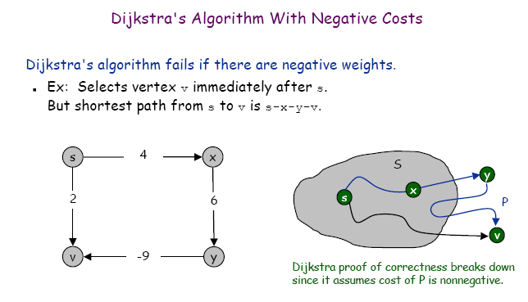
Dijkstra’s Algorithm - negative weights?

Slide 34
Shortest Path Properties
s
Triangle inequality
For all (u, v) ∈ E, we have:
δ(s, v) ≤ δ(s, u) + w(u, v)
u
v
5
2
7
s
u
v
5
2
6

Slide 35
Shortest Path Properties
Upper-bound property
We always have d[v] ≥ δ(s, v) for all v.
Once d[v] = δ(s, v), it never changes.
  The estimate never goes up – relaxation only lowers the estimate
v
5
x
v
5
x
6
∞
6
∞
4
2
4
11
11
6
-2
Relax (x, v)
6
-2
-3
-3
s
0
8
7
s
0
8
7
-4
-4
7
2
7
2
7
∞
7
∞
2
2
9
9
y
z
y
z

Slide 36
Shortest Path Properties
No-path property
If there is no path from s to v then d[v] = ∞ always.
  δ(s, h) = ∞ and d[h] ≥ δ(s, h) ⇒ d[h] = ∞
a
b
-4
h
i
3
-1
2
4
∞
∞
3
c
d
g
6
h, i, j not
reachable
from s
s
0
5
5
11
8
-∞
-8
3
y
-3
∞
2
3
7
-∞
-∞
j
e
-6
f
δ(s, h) = δ(s, i) = δ(s, j) = ∞

Slide 37
Shortest Path Properties
Convergence property
If s u → v is a shortest path, and if d[u] = δ(s, u) at any time prior to relaxing edge (u, v), then d[v] = δ(s, v) at all times afterward.
u
2
v
u
2
v
6
∞
5
8
11
6
∞
5
7
5
11
5
s
0
4
0
4
4
7
4
7

Slide 38
Shortest Path Properties
Path relaxation property
Let p = ⟨v₀, v₁, . . . , v_{k}⟩ be a shortest path from s = v₀ to v_{k}. If we relax, in order, (v₀, v₁), (v₁, v₂), . . . , (v_{k-1}, v_{k}), even intermixed with other relaxations, then d[v_{k} ] = δ(s, v_{k}).
v₁
2
v₂
d[v₂] = δ(s, v₂)
6
∞
v₄
∞
∞
11
5
7
∞
5
3
14
d[v₁] = δ(s, v₁)
4
v₃
s
0
∞
d[v₄] = δ(s, v₄)
11
d[v₃] = δ(s, v₃)

Slide 39
Bellman-Ford Idea
Consider each edge (u,v) and see if u offers v a cheaper path from s
  compare d[v] to d[u] + w(u,v)
Repeat this process |V| - 1 times to ensure that accurate information propgates from s, no matter what order the edges are considered in

Slide 40
Bellman-Ford Algorithm
Single-source shortest paths problem
  Computes d[v] and π[v] for all v ∈ V
Allows negative edge weights
Returns:
  TRUE if no negative-weight cycles are reachable from the source s
  FALSE otherwise ⇒ no solution exists
Idea:
  Traverse all the edges |V – 1| times, every time performing a relaxation step of each edge

Slide 41
BELLMAN-FORD(V, E, w, s)
t
5
x
INITIALIZE-SINGLE-SOURCE(V, s)
for i ← 1 to |V| - 1
do for each edge (u, v) ∈ E
do RELAX(u, v, w)
for each edge (u, v) ∈ E
do if d[v] > d[u] + w(u, v)
then return FALSE
return TRUE
∞
∞
6
-2
-3
s
0
8
7
-4
7
2
∞
∞
9
y
z
t
5
x
∞
∞
6
6
-2
-3
s
0
8
7
-4
7
2
∞
∞
E: (t, x), (t, y), (t, z), (x, t), (y, x), (y, z), (z, x), (z, s), (s, t), (s, y)
7
9
y
z

Slide 42
Example
(t, x), (t, y), (t, z), (x, t), (y, x), (y, z), (z, x), (z, s), (s, t), (s, y)
t
5
x
t
x
Pass 1
Pass 2
5
6
∞
6
∞
4
11
6
-2
6
-2
-3
-3
s
0
8
7
8
7
s
0
-4
-4
7
2
7
2
7
∞
7
∞
9
2
y
z
9
y
z
Pass 3
t
5
x
Pass 4
t
5
x
6
∞
6
∞
2
4
11
2
4
11
6
-2
6
-2
-3
-3
s
0
8
7
0
8
7
s
-4
-4
7
2
7
2
7
∞
7
∞
2
2
9
9
-2
y
z
y
z

Slide 43
Detecting Negative Cycles
for each edge (u, v) ∈ E
do if d[v] > d[u] + w(u, v)
then return FALSE
return TRUE
s
b
0
2
∞
-8
3
∞
c
s
b
s
b
Look at edge (s, b):
d[b] = -1
d[s] + w(s, b) = -4
⇒ d[b] > d[s] + w(s, b)
0
2
∞
-3
2
2
-3
2
-6
-1
-8
3
-8
3
∞
5
5
2
c
c

Slide 44
BELLMAN-FORD(V, E, w, s)
Θ(V)
INITIALIZE-SINGLE-SOURCE(V, s)
for i ← 1 to |V| - 1
do for each edge (u, v) ∈ E
do RELAX(u, v, w)
for each edge (u, v) ∈ E
do if d[v] > d[u] + w(u, v)
then return FALSE
return TRUE
Running time: O(VE)
O(V)
O(E)
O(VE)
O(E)

Slide 45
Key feature
If the graph contains no negative-weight cycles reachable from the source vertex, after |V| - 1 iterations all distance estimates represent shortest paths…why?

Slide 46
Correctness
Case 1: Graph G=(V,E) doesn’t contain any negative-weight cycles reachable from the source vertex s
Consider a shortest path p = < v₀, v₁,..., v_{k}>, which must have k ≤ |V| - 1 edges
By induction:
  d(s) = 0 after initialization
  Assume d(v_{i-1}) is a shortest path after iteration (i-1)
  Since edge (v_{i-1},v_{i}) is updated on the i^{th} pass, d(v_{i}) must then reflect the shortest path to v_{i}.
  Since we perform |V| - 1 iterations, d(v_{i}) for all reachable vertices v_{i} must now represent shortest paths
The algorithm will return true because on the |V|^{th} iteration, no distances will change

Slide 47
Correctness
Case 2: Graph G=(V,E) contains a negative-weight cycle < v₀, v₁,..., v_{k}> reachable from the source vertex s
We have Σ_{i = 1, …, k} w(v_{i-1}, v_{i}) < 0
Proof by contradiction:
Assume the algorithm returns TRUE
Then, d[v_{i}] ≤ d[v_{i-1}] + w(v_{i-1}, v_{i}) for i = 1, …, k. Thus,
  Σ_{i = 1, …, k} d[v_{i}] ≤ Σ_{i = 1, …, k} d[v_{i-1}] + Σ_{i = 1, …, k} w(v_{i-1}, v_{i})
But, Σ_{i = 1, …, k} d[v_{i}] = Σ_{i = 1, …, k} d[v_{i-1}].
Hence, 0 ≤ Σ_{i = 1, …, k} w(v_{i-1}, v_{i}).
Contradicts (*). Thus, algorithm returns false.

Slide 48
Single-Source Shortest Paths in DAGs
u
2
v
Given a weighted DAG: G = (V, E)
  – solve the shortest path problem
Idea:
  Topologically sort the vertices of the graph
  Relax the edges according to the order given by the topological sort
    for each vertex, we relax each edge that starts from that vertex
Are shortest-paths well defined in a DAG?
  Yes, (negative-weight) cycles cannot exist
6
∞
11
5
y
4
4
x

Slide 49
DAG-SHORTEST-PATHS(G, w, s)
topologically sort the vertices of G
INITIALIZE-SINGLE-SOURCE(V, s)
for each vertex u, taken in topologically sorted order
do for each vertex v ∈ Adj[u]
do RELAX(u, v, w)
Running time: Θ(V+E)
Θ(V+E)
Θ(V)
Θ(V)
Θ(E)

Slide 50
Example
6
1
r
s
t
x
y
z
∞
5
0
2
∞
7
∞
-1
∞
-2
∞
3
4
2
6
1
r
s
t
x
y
z
∞
5
0
2
∞
7
∞
-1
∞
-2
∞
3
4
2
6
1
r
s
t
x
y
z
∞
5
0
2
∞
7
∞
-1
∞
-2
∞
2
6
3
4
2

Slide 51
Example (cont.)
6
1
r
s
t
x
y
z
∞
5
0
2
2
7
6
-1
∞
-2
∞
6
4
3
4
2
6
1
r
s
t
x
y
z
∞
5
0
2
2
7
6
-1
6
-2
∞
5
4
3
4
2
6
1
r
s
t
x
y
z
∞
5
0
2
2
7
6
-1
5
-2
∞
4
3
3
4
2

Slide 52
Example (cont.)
6
1
r
s
t
x
y
z
∞
5
0
2
2
7
6
-1
5
-2
3
3
4
2

Slide 53
All-Pairs Shortest Paths - Solutions
Run BELLMAN-FORD once from each vertex:
  O(V²E), which is O(V⁴) if the graph is dense (E = Θ(V²))
If no negative-weight edges, could run Dijkstra’s algorithm once from each vertex:
  O(VElgV) with binary heap, O(V³lgV) if the graph is dense
We can solve the problem in O(V³), with no elaborate data structures

Slide 54
The Floyd-Warshall Algorithm
Given:
  Directed, weighted graph G = (V, E)
  Negative-weight edges may be present
  No negative-weight cycles could be present in the graph
Compute:
  The shortest paths between all pairs of vertices in a graph
2
3
4
1
8
3
2
-4
1
-5
7
5
4
6

Slide 55
The Floyd-Warshall Algorithm
Represent the directed, edge-weighted graph in adjacency-matrix form.
W= matrix of weights =
w_{ij} is the weight of edge (i, j), or ∞ if there is no such edge.
Return a matrix D, where each entry d_{ij} is δ(i,j).
Could also return a predecessor matrix, P, where each entry p_{ij} is the predecessor of j on the shortest path from i.

Slide 56
Floyd-Warshall: Idea
Consider intermediate vertices of a path:
i
j
Say we know the length of the shortest path from i to j whose intermediate vertices are only those with numbers 1, 2, ..., k-1. Call this length
Now how can we extend this from k-1 to k? In other words, we want to compute . Can we use , and if so how?

Slide 57
The Structure of a Shortest Path
k is not an intermediate vertex of the shortest path p
  Shortest path from i to j with intermediate vertices from {1, 2, …, k} is a shortest path from i to j with intermediate vertices from {1, 2, …, k - 1}
k is an intermediate vertex of the shortest path p
  p₁ is a shortest path from i to k
  p₂ is a shortest path from k to j
  k is not intermediary vertex of p₁, p₂
  p₁ and p₂ are shortest paths from i to k with vertices from {1, 2, …, k - 1}
k
i
j
p₁
∞
p₂
k
j
i

Slide 58
Floyd-Warshall Idea,3
Thus,
When k = |V|, we’re done.

Slide 59
Dynamic Programming
Floyd-Warshall is a dynamic programming algorithm:
  Compute and store solutions to sub-problems. Combine those solutions to solve larger sub-problems.
  Here, the sub-problems involve finding the shortest paths through a subset of the vertices.

Slide 60
The Floyd-Warshall algorithm
Floyd-Warshall(W)
Running Time: O(n³)

Slide 61
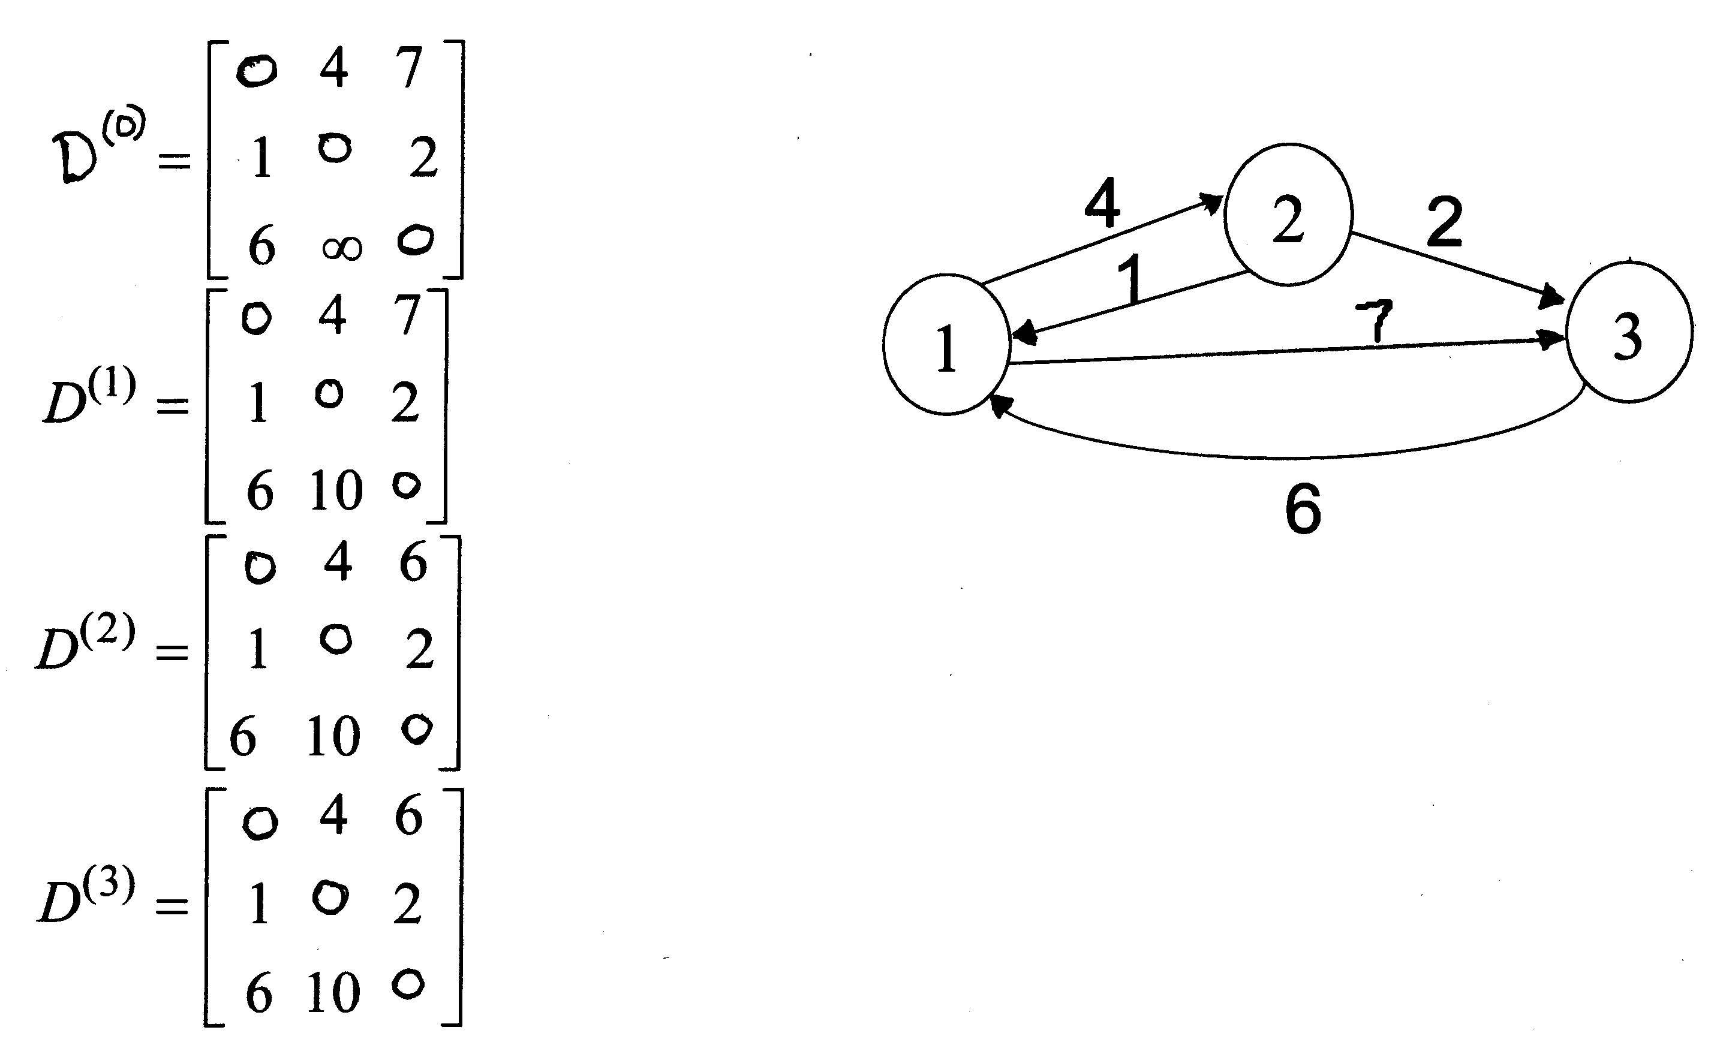
Example of Floyd-Warshall

Slide 62
Computing predecessor matrix
How do we compute the predecessor matrix?
  Initialization:
  Updating: p^{(k)}(i,j) = p^{(k-1)}(i,j) if(d^{(k-1)}(i,j)<=d^{(k-1)}(i,k)+(d^{(k-1)}(k,j)
  p^{(k-1)}(k,j) if(d^{(k-1)}(i,j) > d^{(k-1)}(i,k)+(d^{(k-1)}(k,j)

Slide 63
Example
d_{ij}^{(k)} = min {d_{ij}^{(k-1)} , d_{ik}^{(k-1)} + d_{kj}^{(k-1)} }
D⁽⁰⁾ = W
D⁽¹⁾
2
1
2
3
4
5
1
2
3
4
5
3
4
1
0 | 3 | 8 | ∞ | -4
∞ | 0 | ∞ | 1 | 7
∞ | 4 | 0 | ∞ | ∞
2 | ∞ | -5 | 0 | ∞
∞ | ∞ | ∞ | 6 | 0
1
0
3
8
∞
-4
1
8
3
2
2
∞
0
∞
1
7
2
1
3
3
∞
4
0
∞
∞
-4
7
-5
5
4
4
4
2
5
-5
0
-2
6
5
5
∞
∞
∞
6
0
D⁽²⁾
1
2
3
4
5
D⁽³⁾
D⁽⁴⁾
1
0
3
8
4
-4
0
3
8
4
-4
0
3
-1
4
-4
2
∞
0
∞
1
7
∞
0
∞
1
7
3
0
-4
1
-1
3
∞
4
0
5
11
∞
4
0
5
11
7
4
0
5
3
4
2
5
-5
0
-2
2
-1
-5
0
-2
2
-1
-5
0
-2
5
∞
∞
∞
6
0
∞
∞
∞
6
0
8
5
1
6
0

Slide 64
Example
d_{ij}^{(k)} = min {d_{ij}^{(k-1)} , d_{ik}^{(k-1)} + d_{kj}^{(k-1)} }
D⁽⁵⁾
P⁽⁵⁾
2
1
2
3
4
5
1
2
3
4
5
3
4
1
0 | 1 | -3 | 2 | -4
3 | 0 | -4 | 1 | -1
7 | 4 | 0 | 5 | 3
2 | -1 | -5 | 0 | -2
8 | 5 | 1 | 6 | 0
1
-
3
4
5
1
1
8
3
2
2
4
-
4
2
1
2
1
3
3
4
3
-
2
1
-4
7
-5
5
4
4
4
4
3
4
-
1
6
5
5
4
3
4
5
-
Source: 5, Destination: 1
Shortest path: 8
Path: 5 …1 : 5…4…1: 5->4…1: 5->4->1
Source: 1, Destination: 3
Shortest path: -3
Path: 1 …3 : 1…4…3: 1…5…4…3: 1->5->4->3

Slide 65
PrintPath for Warshall’s Algorithm
PrintPath(s, t)
{
if(P[s][t]==nil) {print(“No path”);return;}
else if (P[s][t]==s){
print(s);
}
else{
print_path(s,P[s][t]);
print_path(P[s][t], t);
}
}
Print (t) at the end of the PrintPath(s,t)

Slide 66
Transitive closure of the graph
Input:
  Un-weighted graph G: W[i][j] = 1, if (i,j)∈E, W[i][j] = 0 otherwise.
Output:
  T[i][j] = 1, if there is a path from i to j in G, T[i][j] = 0 otherwise.
Algorithm:
  Just run Floyd-Warshall with weights 1, and make T[i][j] = 1, whenever D[i][j] < ∞.
  More efficient: use only Boolean operators

Slide 67
Transitive closure algorithm
Transitive-Closure(W[1..n][1..n])
01 T ← W // T⁽⁰⁾
02 for k ← 1 to n do // compute T^{(k)}
03 for i ←1 to n do
04 for i ←1 to n do
05 T[i][j] ← T[i][j] ∨ (T[i][k] ∧ T[k][j])
06 return T

Slide 68
The End

